Slide 1
The Evolution of Strategy

Slide 2
Purpose
What is the purpose of a business?
“The only valid purpose of a firm is to create a customer.” Peter Drucker.
Get customers and keep them.

Slide 3
Strategy
Michael Porter of the Harvard Business School developed the concept of strategy around 1980.
Before that HBS taught business planning and policy, not competitive strategy.
Porter developed the five forces approach to strategy.

Slide 4
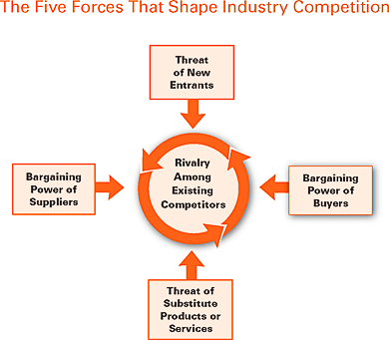
“The Five Competitive Forces That Shape Strategy,” Michael Porter, Harvard Business Review, January 2008.

Slide 5
Strategy became not only a required course in business schools, but the primary focus.
Consulting companies grew huge by selling strategy advice and research.
Large, centralized corporate strategy departments grew in importance and power.
The most important goal of competitive strategy was to build businesses with high barriers to entry.
E.G. The media: newspapers, TV, radio (licensed), magazines, cable (high capital costs, franchises).

Slide 6
Porter’s three primary strategies to create competitive advantage:
Differentiation
Pepsi
Focus (niche)
Patek Phiiippe
Low cost producer
WalMart

Slide 7
Shareholder Value
In the late 1980s, again the Harvard Business School led the way in a new business theory: maximizing short-term shareholder value.
Quarterly profits were vastly more important than customers.
Profits were measured in ratios and percentages, not cash.
Strategy focused on competitors.
Shareholder value focused on profits.

Slide 8
Teaching of maximizing shareholder value created squadrons of MBAs with financial skills and values.
Beancounters who wanted to delight shareholders.
The concept of maximizing shareholder value came before the Internet wiped out barriers to entry and decimated an imbalance of knowledge that previously favored corporations.

Slide 9
Before the Internet
Porter wrote the initial model for the Five Forces in 1979.
He wrote his seminal book Competitive Strategy in 1981 and Competitive Advantage in 1985.
Before the Internet
Before Google
Before Napster, iTunes, and the iPod, iPhone, and iPad
Before craigslist.com
He didn’t consider how to compete with free.

Slide 10
Before Behavioral Economics
Porter made his major contributions to strategy theory before behavioral economics research.
BE research has shown that people do not make rational decisions (emotions dominate) and that markets are not rational.
That success is more often the result of luck (randomness) than carefully planned strategy.
Delighting customers with awesome products is the key now, not having barriers to entry.

Slide 11
With the Internet, power shifted to the customer.
Apple became the most valuable company in the world by focusing on products, not profits.
Steve Jobs: “Delight customers”
Amazon became the world’s biggest retailer by putting customers first – intimate customer relationships and knowledge.
Google became the largest media company in the world by organizing the world’s information and making it universally accessible and useful.

Slide 12
Now the three basic strategies are:
Low-cost producer
Continuous innovation
Delighting customers

Slide 13
Unit of analysis has changed from the customer to what job the customer needs to have done.
People hire products to do a job.
Why did people hire a milkshake?
http://gartner.mediasite.com/mediasite/play/9cfe6bba5c7941e09bee95eb63f769421d?t=1320659595

Slide 14
What job did consumers used to …
Hire newspapers for?
Hire magazines for?
Hire television for?
Hire radio for?

